Slide 1
Projects & Environmental BRANCH overview of 2015/16 Achievements
March 25, 2016
AGENDA ITEM 11D
Notes:
ERIC
Pointer – visible
Good afternoon President Edgar, Vice President Suarez, Secretary Dolan and Board members. I am Eric Butler, Supervising Engineer and Chief of the Board’s Projects and Environmental Branch.
Presenting with me today will be Senior Environmental Scientist James Herota (pause), Senior Engineer Nancy Moricz (pause) and Senior Engineer Ali Porbaha (pause).
Before the staff make their presentations I’d like to recall events which led to creation of the Branch, and to look at two important drivers which have guided our efforts.
* CLICK to next slide *

Slide 2
Background
2007 Flood Legislation:
reconstituted the Reclamation Board as the Central Valley Flood Protection Board
required DWR to prepare, and the Board to adopt, a Central Valley Flood Protection Plan
established an urban level of flood protection, and
required the Board to review and comment on the safety elements of city and county General Plans, and to provide technical support to those local agencies
In response to the legislation and subsequent budget changes in 2008:
Branch established in 2009
Staff provides collaborative inter-agency / stakeholder coordination and solution-building support to plans, programs, and projects
Notes:
ERIC
* CLICK *
In 2007 the Legislature passed and the Governor signed a sweeping set of important flood legislation which, among numerous other actions:
reconstituted the Reclamation Board as the Central Valley Flood Protection Board
required DWR to prepare, and the Board to adopt, a Central Valley Flood Protection Plan
established an urban level of flood protection, and
required the Board to review and comment on safety elements of city and county General Plans, and to provide technical support to those agencies.
* CLICK *
In response to this legislation and subsequent financing, the Branch was established in 2009. Since then staff engineers and environmental scientists have provided collaborative inter-agency and stakeholder coordination, and solution-building support to several plans, programs, and projects.
* CLICK to next slide *

Slide 3
Introduction
Governor’s Water Action Plan:
Increase Flood Protection
Protect and Restore Important Ecosystems
Achieve the Co-Equal Goals for the Delta
Increase Regional Self-Reliance and Integrated Water Management Across all Levels of Government
Board Strategic Plan:
Preserve integrity and function of flood protection systems in the Central Valley
Oversee implementation of the Central Valley Flood Protection Plan
Provide leadership in optimizing flood protection planning, management and operations
Develop broad public support for regional and system-wide multi-benefit flood risk reduction projects and programs
Notes:
ERIC
In support of the Governor’s Water Action Plan, the State evaluates water issues from a broad and strategic perspective by planning and implementing water management programs that combine flood management, ecosystem enhancement, water supply, water quality and other management actions to deliver multiple benefits across watershed and jurisdictional boundaries.
This approach calls for pulling together multiple disciplines and interests to define problems and opportunities, and then working creatively and collaboratively to achieve practical, cost-effective, and sustainable multi-benefit solutions.
* CLICK *
Branch activities support several actions of the Governor’s Water Action Plan related to flood protection, ecosystems, co-equal Delta goals, regional self-reliance and integrated water management.
* CLICK *
while supporting the following goals of the Board’s Strategic Plan:
Read off the screen
James Herota will present next… * NO CLICK *

Slide 4
Environmental Analysis / Compliance
Staff reviewed and promoted multi-benefit projects for flood risk reduction, ecosystem restoration, and recreational opportunities and:
reviewed over 9,500 State Clearinghouse Notices
reviewed environmental documents pursuant to CEQA and NEPA
provided comments to lead agencies
reviewed and collaborated on over 130 permit applications (environmental documents, design plans and specifications) to ensure that the projects:
  complied with California Code of Regulations, Title 23
  resulted in no adverse hydraulic or geotechnical impacts
  were consistent with the 2012 Central Valley Flood Protection Plan
  had no adverse impact on State Plan of Flood Control facilities
  complied with all USACE permitting and 408 decisions
Notes:
JAMES
Switched order of opening sentence
Replaced “native habitat and fish passage improvements” with “ecosystem restoration”
Added a final bullet on USACE permitting and 408 decisions.

Slide 5
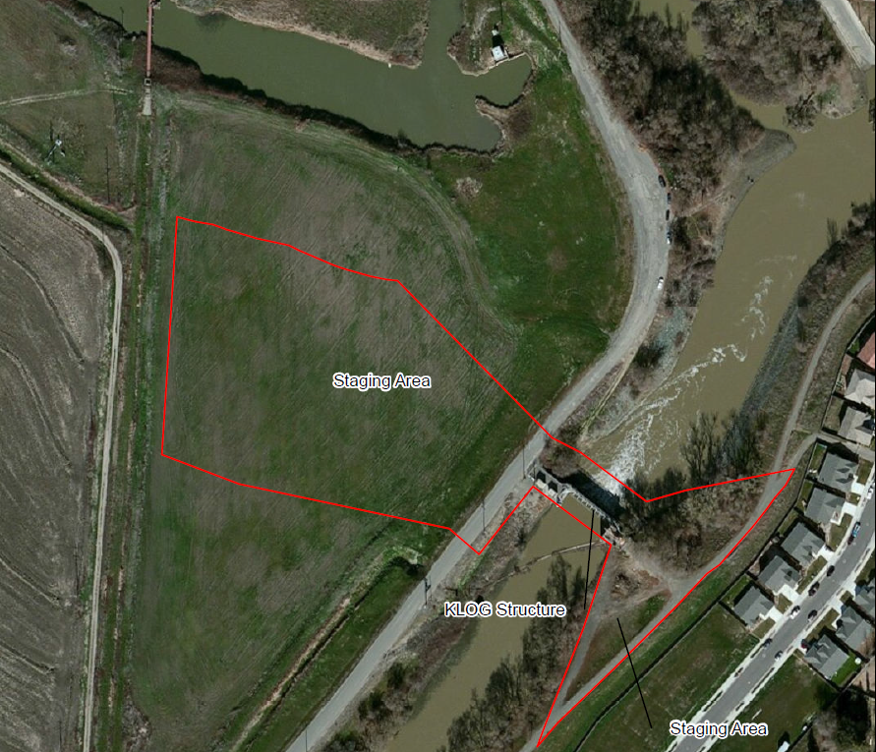
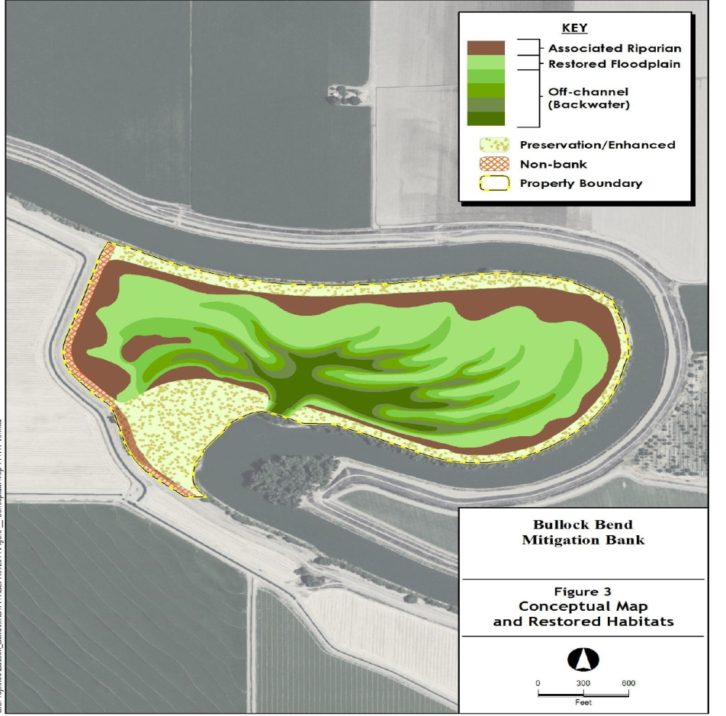
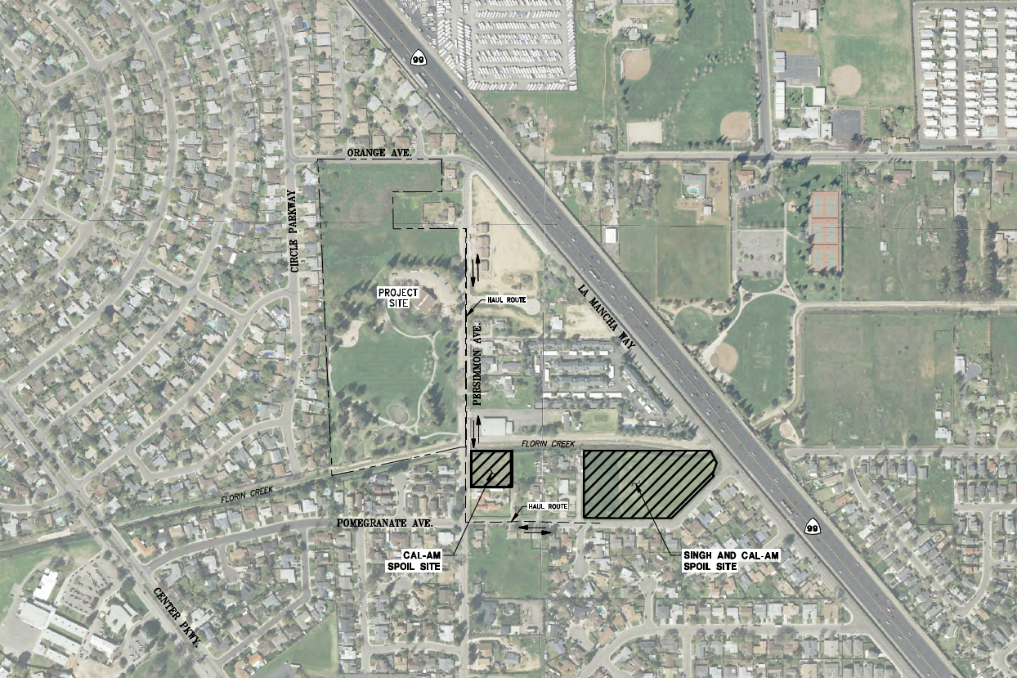
Multi-Benefit / Habitat Restoration
Notable multi-benefit projects:
Knights Landing Outfall Gates Fish Passage Alteration (CA Eco Restore) – prevent salmon entry and stranding in the Colusa Basin Drain (completed Oct)
Florin Creek Multi-Use Basin – flood stage reduction detention basin and habitat features (part of South Sacramento County Streams Project, issued Jan 2016)
Ecosystem Restoration and Floodwater Attenuation – reduce San Joaquin River flood stage and improve floodplain connectivity over 2,500 acres of refuge habitat (conditional approval Dec)
Bullock Bend Restoration - breach existing farm berm to reduce Sacramento River flood stage and restore floodplain function (Board action March 2016)
Notes:
JAMES

Slide 6
Board Sponsored Projects / Studies
Staff provided guidance, document review, support and coordination for Board sponsored / USACE led projects and studies, including:
Central Valley Integrated Flood Management Study
Sacramento River General Reevaluation Report (GRR)
American River Common Features & West Sacramento GRRs
Lower San Joaquin River Feasibility Study
Marysville Ring Levee
South Sacramento County Streams Project
Staff has improved coordination of Board Sponsored Projects and Studies by:
providing guidance and collaboration to DWR project design teams
tracking progress and status of all projects and studies through weekly coordination with DWR Flood Projects Office project managers
coordinating Board briefings and actions
Notes:
NANCY
Changed “American River Watershed” to “American River Common Features & West Sacramento GRRs”
Added Lower San Joaquin River Feasibility Study, Marysville Ring Levee, and South Sacramento County Streams Project
Tweaked language in the lower section of 3 bullets

Slide 7
CVFPP Implementation
Staff provided multi-agency guidance and collaboration to implement efforts and management actions of the 2012 Central Valley Flood Protection Plan including:
Coordinating Committee
Conservation Strategy Advisory Committee
Regional Flood Management Plans
Basinwide Feasibility Studies
Preparations to support adoption of the 2017 CVFPP update
Notes:
NANCY

Slide 8
2017 CVFPP Update
In preparation for the 2017 CVFPP update, staff is proposing Plan Adoption / Implementation teams consisting of staff, legal and Board members
Teams provide transparency, consistency, timely delivery and efficient adoption
Proposed CVFPP 2017 Review and Integration Teams
FSSR and SPFC DD Review Team
RFMPs and BWFS Integration Team
OMRRR Integration Team
CVFPP Investment Strategy Integration Team
CVFPP Update Team
Board
Conservation Strategy Integration Team
Supplemental PEIR Review Team
Public Comment Analysis Team
Notes:
NANCY
Updated bullets based on Nancy’s coordination with Mary Jimenez

Slide 9
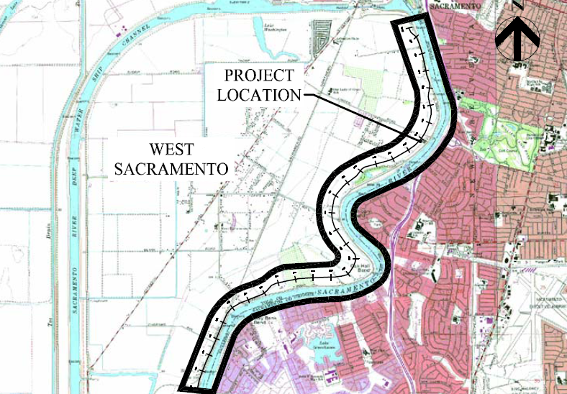
Flood System Alteration Projects
Engineering and Environmental staff:
processed 17 flood system alteration (USACE 408) project applications
provided guidance on planning, design, permit application, technical review, USACE/Board/DWR coordination, design reviews, resolving construction issues
  Sacramento Area Flood Control Agency: North Sacramento Streams, Sacramento River East Levee
  Sutter Butte Flood Control Agency, Feather River West Levee Project
  Three Rivers Levee Improvement Authority : Yuba River, Goldfields, Western Pacific Interceptor Canal
  West Sacramento Area Flood Control Agency, Southport Project
collaborated with USACE Sacramento District 408 staff, DWR, and the local project sponsors and stakeholders
Notes:
ALI
Provided more detailed project examples
Added statement about collaboration with USACE/DWR and local sponsors and stakeholders

Slide 10
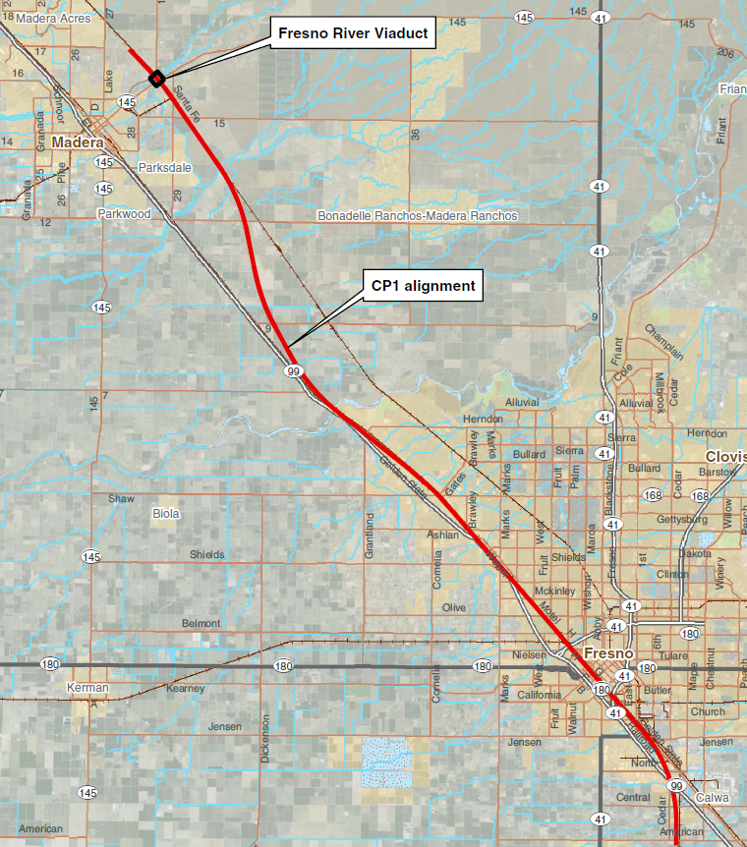
Bridge and Rail Projects
Engineering and Environmental staff:
processed 17 bridge and rail project applications
CA High Speed Rail Authority
  first Board-approved HSRA application (April) for Fresno River viaduct
  coordination on upcoming Construction Package 2 / 3
State and Local Bridges
  16 Board-approved projects for Caltrans, UPRR and local agencies
  all bridge applications (except HSR) were transferred to Operations Branch in December 2015
Notes:
ALI
Added bullet on transfer to Operations Branch

Slide 11
Other Branch Activities
Staff assisted the Executive Officer and the Board on several special assignments:
Regulatory Review and Comment to General Plan Safety Elements
Consultation Policy with DSC on the Delta Levee Investment Strategy
Participation on Panels, Programs and Briefings to State, Local and Federal partners and Stakeholders:
  Assembly Committee on Water, Parks and Wildlife
  Assembly Budget Subcommittee on Resources and Transportation
  Senate Budget and Fiscal Review Committee for Budget Subcommittee on Resources, Environmental Protection, Energy and Transportation
  Board Workshop on Board Operations Funding Options
  World Affairs Forum 2015: The Politics of Water, Juneau, Alaska
  USACE Civil Works Review Board, Washington D.C.
Notes:
ALI

Slide 12
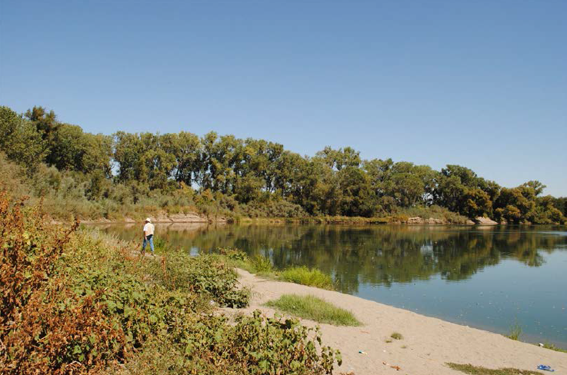
QUESTIONS
Presented by: Eric Butler, PE – Supervising Engineer
Nancy Moricz, PE – Senior Engineer
Ali Porbaha, PE – Senior Engineer
James Herota – Senior Environmental Scientist
Notes:
All staff available for questions

